Slide 1
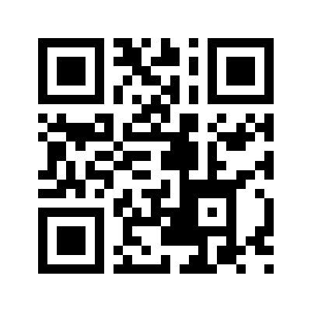
【2025 Spring Application Guidance】
Date : April 4th, 2025 17:00～17:30
Online (Zoom) https://x.gd/Wgar6
Language: English
Registration: not necessary
The Career Development Program for International Professionals aims to support international students in their career development immediately after enrollment, so that they can be active in society not only in academia, but also in business, international organizations, and as entrepreneurs.
Program completion requirement: at least 5 credits in total
Japanese language At least 2.5 credits
Japanese language courses (7 level 32 courses from Beginning, Intermediate to Advanced)
Japanese Intensive short course
Career support
Individual career advice
Alumni lectures
Practical guidance for interview tests
Cooperation with the Career Support Office and employment officers of each department
Career education At least 1.5 credits
Japanese Career Bridge・Japanese Career Design
Entrepreneurship I, II
Engineering literacy II - Business strategy and intellectual property-
Advanced Technology Special Lecture I, II
Internship At least 1 credit
Engineering Competency I -Project Based Learning-
Engineering Competency II -Research Internship-
Creativity Engineering Project I, II
Research Internship I
Certificate of completion
Students who have completed the prescribed credits will receive a program completion certificate to assist them in their job search
Applicable Student
International students in a master's or doctoral course and are interested in finding a job in Japan. Not only to find a job in a company but also to develop a career in academia or to start a business
Scholarship
Financial support is provided from the priority quota of the Japan Student Services Organization (JASSO) Study Incentive Fund
https://www.cdips.t.u-tokyo.ac.jp/
ryugakusei.career-group@g.ecc.u-tokyo.ac.jp

