Slide 1


国際高度人材キャリア開発プログラム
Career Development Program for International Professionals (CDIP)
GUIDANCE
CDIPs Program Office
The Institute of Innovation in International Engineering Education,
School of Engineering,
The University of Tokyo
この写真 の作成者 不明な作成者 は CC BY-NC のライセンスを許諾されています

Slide 2






Career Development Program for International Professionals (CDIP)
Concept
  We will provide the necessary support for your career development in which your potential could be fully activated in the Japanese social environment.
Eligible students
  Any international graduate students who are interested in starting a career in Japan
Notes:
We are here to support career development for those who want to continue your career in Japan after completion of your study.

Slide 3
Certificate/Scholarship
Certificate of completion
  Presenting at seeking employment
  Signed by President of the University of Tokyo
  Priority when you change the visa status
Scholarship granted to this program
  Registered students are eligible to apply
  FY 2025, from April 2025 for 12 months (expected)
    JASSO: 13 students, 48,000Yen/Month×12
    JASSO: 9 students, 20,000Yen/Month×12
※Image
Monbukagakusho
Honors Scholarship
for Privately-Financed
International Students
For further inquiry Email: inquiry@cdip.t.u-tokyo.ac.jp

Slide 4
Course requirements for certificate
  At least 5.0 credits from following three sections:
  Japanese (≧2.5 credits), Career Education (≧1.5 credits), Internship (≧1 credit)
1
2
3
Japanese proficiency： Above N2 level, Master student or Doctoral student
Enrollment
Orientation
Take Entrepreneurship on-demand
lectures
1st year, 1st Semester
Advance Japanese
1st year, 2nd Semester
Business Japanese
Carrier Education
2nd year, 1st semester
Internship /Talks with OB・OG
    Career support
    Private
    counselling
Japanese proficiency： N3 level, Master student or Doctoral student
Enrollment
Orientation
Take Entrepreneurship on-demand lectures
1st year, 1st Semester
Intermediate Japanese
1st year, 2nd Semester
Business Japanese
Carrier Education
2nd year, 1st semester
Internship /Talks with OB・OG
    Career support
    Private
    counselling
Japanese Beginner, Doctoral student, or master student who seek to enter Doctoral course
Enrollment
Orientation
Take Entrepreneurship
on-demand lectures
1st year, 1st Semester
General Japanese
1st year, 2nd Semester
Intermediate Japanese
2nd year, 1st Semester
Business Japanese
Carrier Education
2nd year,2nd semester
Internship /Talks with OB・OG
    Career support
    Private
    counselling

Slide 5
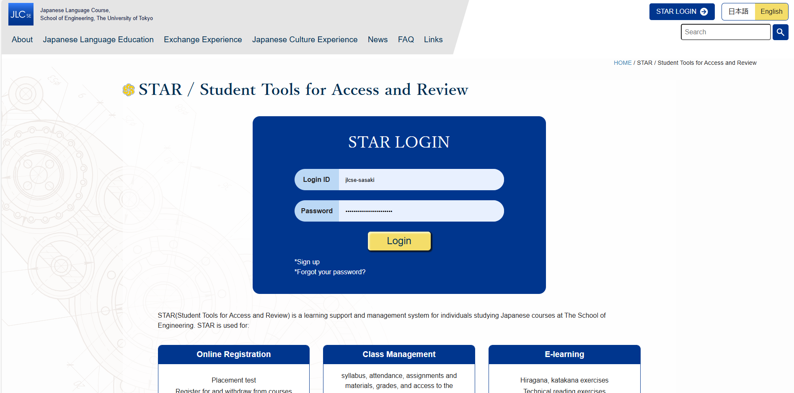
1. Japanese
Japanese Language Course School of Engineering (JLCSE)
https://www.jlcse.t.u-tokyo.ac.jp/en/
Objective: Offering Japanese language education for graduate students and researchers at the School of Engineering to obtain Japanese language ability for daily living and specialized research work
Period: 2 semesters/year April (S1S2) & October (A1A2) 14 weeks/semester
Courses : 7 level 32 courses (Beginning, Intermediate, Advanced)
Credits: 2 credits per once-a-week course
Registration: STAR (Students Tools for Access and Review)
https://www.jlcse.t.u-tokyo.ac.jp/en/star-en/
Deadline for S semester of 2025: April 14, 2025
STAR

Slide 6
1. Japanese
Japanese Language Course School of Engineering (JLCSE) Course Steps
https://www.jlcse.t.u-tokyo.ac.jp/en/
Beginning
Ⅰ
Beginning Ⅱ
Inter-mediate 1
Inter-mediate 2
Inter-mediate 3
Advanced 1
Advanced 2
Level
Integral
Multicultural
Study P.
Career Bridge
Career Design
InteAgral
Tech Term/ Kanji
Integral
Integral
*
Integral
Beg.4
Listening
Course
Beg. 1
Beg.３
Listening
Beg.2
Listening
Listening
Listening
Intro-
ductory
Speaking
Speaking
Speaking
Speaking
Speaking
Tech. Reading
Reading
Tech.
Reading
Reading
Reading
Intensive Beg.Ⅰ
Intensive Beg.Ⅱ
Writing
Writing
Writing
Writing
Writing
Make a plan and take Japanese Language courses！
For CDIPs

Slide 7
1. Japanese
Japanese language requirements for CDIPs
Internship
Career Education
2.5 credits or more
Japanese courses/Intermediate 3, Advanced 1・2
Summer and Winter Intensive Courses/Business Japanese
On-demand Video Streaming/Business Japanese
N1
N2
2 credits
0.5 credit
N2
N2
0.5 credit
Entrepreneurship
Email: inquiry@cdip.t.u-tokyo.ac.jp

Slide 8
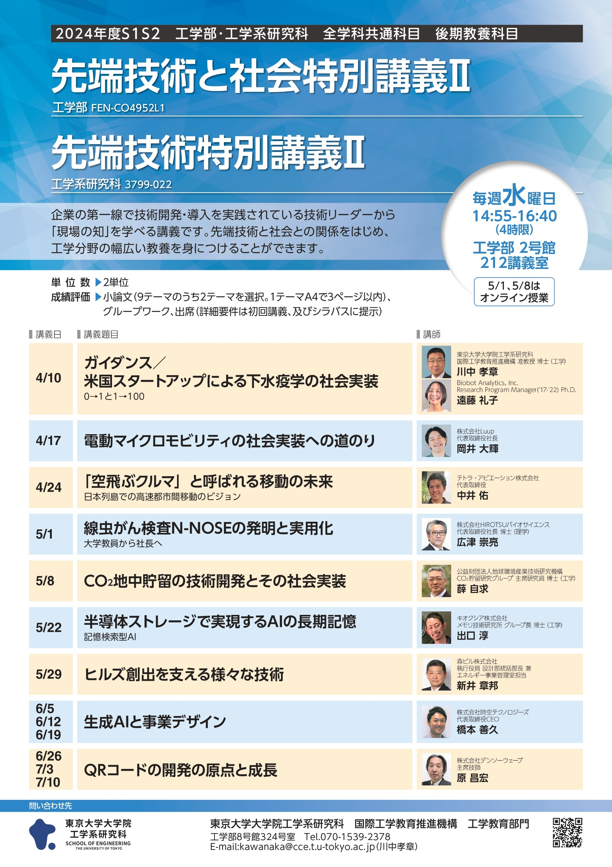
Career Education
2. Career education
Entrepreneurship
  Entrepreneurship I,II (3799-371, 3799-372 : 1 credit)
  On-demand lectures (five videos)
Japanese Career Bridge（2 credits)
Japanese Career Design（2 credits）
  Intensive Course/Career (0.5 credit)
  On-demand Video Streaming/Career (0.5 credit)
Engineering Literacy I,II
  Business Strategy & Intellectual Property
  (3799-150: 1 credit)
Frontier of Technology I,II
（3799-021, 3799-022: 2 credits）

Slide 9
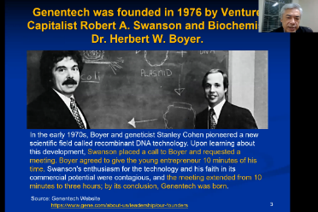
Career Education
2. Career education
Entrepreneurship on-demand lectures
You can reflect on career through learning entrepreneurship which is important even for people who do not start their own businesses
This is a beginner-level course. If you wish to explore the topic further, we encourage you to enroll in advanced courses or programs.
You can watch lectures on https://www.cdip.t.u-tokyo.ac.jp/
Introduction
Session 1 | Challenges Facing Innovation Ecosystem in Japan
Session 2 | What is Entrepreneurship?
Session 3 | University Entrepreneurship Ecosystem at the University of Tokyo
Session 4 | University’s Support for Entrepreneurial Students

Slide 10
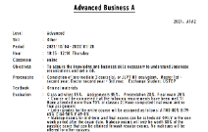

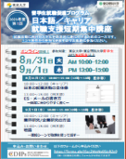
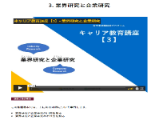
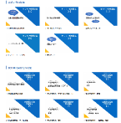
Career Education
2. Career education
Internship
Career Support
Japanese Career Design (2 credits)
https://www.jlcse.t.u-tokyo.ac.jp/en/
Japanese Career Bridge (2 credits)
Summer and Winter, Intensive Course/Career (0.5 credit)
On-demand Video Streaming/Career (0.5 credit)
https://www.cdip.t.u-tokyo.ac.jp
N1
N2
N2
Japanese Courses

Slide 11
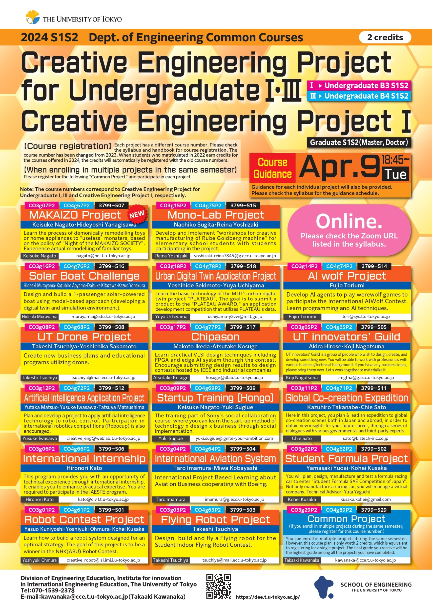
Internship
3. Internship
General internship
  Work at company as a Trainee
  Engineering competency II -research internship-
  （3799-147 2credits）
  Science and technology/practice training 1〜4,
  Internship, Research internship Ⅰ
  Internship found by yourself may be counted
Project based learning
  Make solution for problems provided by company
  Engineering competency I -Project Based Learning-
  (3799-146 2credits)
  Creative Engineering Project I, II (3799-024, 3799-023
  : 2 credits)
  Joint research project with company may be counted
Duration more than 2 weeks (10days)

Slide 12
Engineering Competency II -Research Internship- (3799-147) 2 Credits
3. Internship
Internship
Companies offer research theme for the internship
  Coop-J consortium (from Oct. ’21)
    45 companies, Salary will be paid
  C-Engine program (Consortium)
    26 companies / 17 Univ.
  Toshiba, (Evonik, Airbus, Apollo tires, Repsol)
  2 months or longer and report
Please contact GMSI office for the detail
Registration deadline, Preparation procedure etc.
Research Internship Guidance
Date：May 8th. 2025
16:50-18:00
Venue: Online (ZOOM)
https://u-tokyo-ac-jp.zoom.us/j/89619725172?pwd=GpMzWoLeLyknEqUaEISXghYxlbbcdg.1
GMSI (Graduate school of Mechanical System Innovation)
E-mail: office@gmsi.t.u-tokyo.ac.jp
URL: https://gmsi.t.u-tokyo.ac.jp/

Slide 13
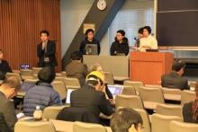
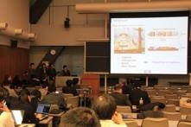
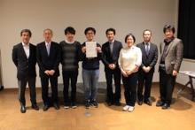

Engineering Competency I -Project Based Learning (PBL)-
3. Internship
PBL, which is one of active learning, aims to cultivate ability to succeed in Industry, Government, and Academia through problem setting/solving through coordination and integration, based on needs-oriented approach and challenges to the subjects from Industry.
PBL is promoted by each of group, consisting of 5 – 6 members students from different fields, laboratories, nationalities, and young faculty staffs.
Previous comments from participants said that PBL offers good opportunities for:
  Training of teamwork/communication.
  Creation of hints for new business models by mixing knowledge of industry and academia, based on fresh ideas and perspective of students.
From 2009 to 2020, PBL provided the total 57 interesting themes offered from 21 companies, and 2 departments of UTokyo.
Project
Project manager (Industry)
Leader (Student)
Member (Students)
Facilitator (Young faculty)
Customer
(Industry)
Theme
Solution
Supervise, Advise
Supervisor
(Senior faculty)
Evaluate, Advise
Final Presentation(Industry, Faculty, Students)
PBL implementation framework
No. | Company | Title
1 | East Japan Railway Company | New communication support using haptics or other technologies in the railway field
2 | Ebara Corporation | Future business under the keyword of “universe”
3 | Tokyo Gas Co.Ltd. | Development of new businesses utilizing Electric Vehicle
4 | Mitsui O.S.K. Lines, Ltd. | Shipping innovation for next generation
PBL themes and participating companies in 2021
No | Company | Title
1 | Hitachi Astemo, Ltd. | Business Model for Connected Autonomous Vehicle Services
2 | Ebara Corporation | Platform business produced by a manufacturer
3 | System JD CO., Ltd. | Verification of the 6th Basic Energy Plan for "Island"
Final presentation

Slide 14
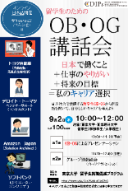




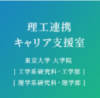

Career Support
Supports and Opportunities to develop Career for International Students
Interact with
Alumni
Practice
Japanese Interview
Consult about
Individual Careers
2 times a year
(Summer & Winter)
interact with alumni
and learn about various industries and careers
Practice Session of Japanese
・Group Interview,
・Group Discussion
・Interview manners
・Consult about general job-hunting in Japan
・Correction of Japanese documents
・Personal career counseling
For more information about specific recruiting companies and recommended applications,
please contact your department‘s employment office or
Career Office for Faculty of Engineering and Science
理工連携キャリア支援室 http://t-career.t.u-tokyo.ac.jp/
Eng. 2, Room 208

Slide 15
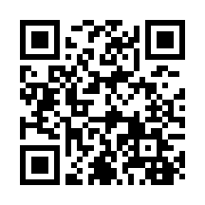
国際高度人材キャリア開発プログラム
Career Development Program for International Professionals (CDIP)
(Formerly called 留学生就職促進プログラム)
Register to download the form from CDIP website
URL: https://www.cdips.t.u-tokyo.ac.jp/
Email: inquiry@cdip.t.u-tokyo.ac.jp
On-demand lectures: https://www.cdip.t.u-tokyo.ac.jp/ (without “s”!!)

Slide 16




Japanese Language Class School of Engineering(JLCSE)
Join the Japanese language class, learn a lot, and have fun！
【JLCSE Educational vision】
- Support for
1) learning Japanese and
2) communication with people to have a mutual understanding.
＊CDIPｓ
Global campus
Global society
Multilingual and multicultural society
Culture
Kimono and yukata workshops
Japanese 32 courses
Beginning 7
Internatio- nalization
Internatio-nal exchange
International Lounge
Tea ceremony workshop
etc
Intermediate 16
Advanced 9
Promoting internationalization of Japanese students @partner universities overseas
Student Volunteers
Basic Japanese ability
Source of symbiosis
Communication skills
Japanese ability specialized in engineering
Course students | 750人
Number of countries | 50+
Hands-on Activities

